Slide 1
Final Engagement
Attack, Defense & Analysis of a Vulnerable Network
Sofia Gaglione- Cybersecurity Bootcamp
Columbia University

Slide 2
Table of Contents
This document contains the following resources:
Network Topology & Critical Vulnerabilities
Traffic Profile
Normal Activity
Malicious Activity

Slide 3
Network Topology
& Critical Vulnerabilities
‹#›

Slide 4
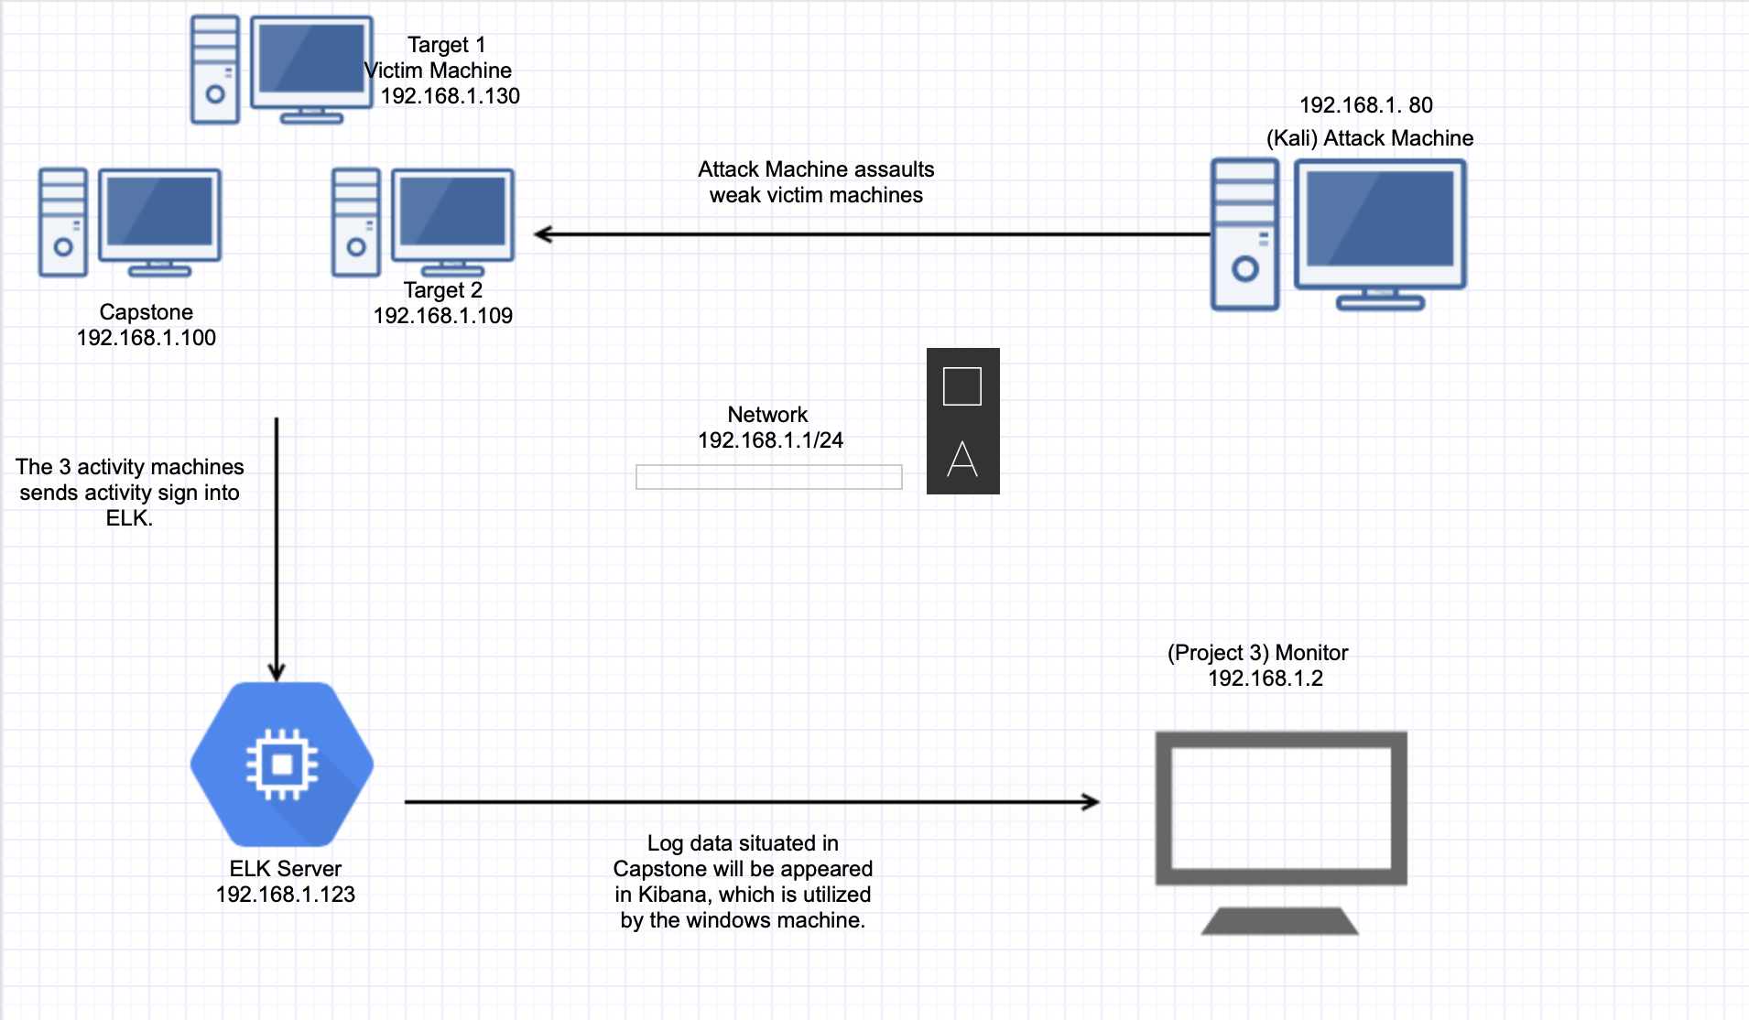
Network Topology
Network
Address Range:
Netmask: 255. 255.255.0
Gateway: 192.168.1.2
Machines
IPv4: 192.168.1.80
OS: Linux
Hostname: Kali Machine
IPv4: 192.168.1.130
OS: Linux
Hostname: Target 1
IPv4:192.168.1.109
OS: Linux
Hostname: Target 2
IPv4: 192.168.1.123
OS: Linux
Hostname: ELK
IPv4: 192.168.1.100
OS: Linux
Hostname: Capstone

Slide 5
Critical Vulnerabilities: Target 1
Our assessment uncovered the following critical vulnerabilities in Target 1.
Vulnerability | Description | Impact
Accessible usernames in in WordPress | Recognize legitimate usernames on systems | An attacker needs to assemble data which will decide how they will approach the attack
Access to Port 22 SSH | Unless secured, port 22 is vulnerable to brute-force attacks | A hacker is able to use this to their advantage due to them to being able to create an attack
Privilege Escalation | Gives users access to python | An attacker can change the privilege of the user (s) and obtain admin privileges
Cron Attacks | Unreliable version | Unpatched form can be misused through vulnerabilities

Slide 6
Critical Vulnerabilities: Target 2
Our assessment uncovered the following critical vulnerabilities in Target 2.
Vulnerability | Description | Impact
URL files that are exposed to attacks | How the attack is able to steal critical information from a file | The attacker is able figure how to about the attack
Easy access to wordpress directories | Files/directories are easy to access | Hacker is able to gain access to directories/files
Reverse shell in netcat | Attackers who effectively exploit a distant order execution weakness can utilize an opposite shell to acquire an intuitive shell meeting on the objective machine and proceed with their attack. | Anyone can obtain access to the system
ggggogpgppgpgpgspgrmgg | grskgoegsgjesogesojgeosjg | gesjogsgjesgjoesjgesojgeso

Slide 7
Traffic Profile
‹#›

Slide 8
Traffic Profile
Our analysis identified the following characteristics of the traffic on the network:
Feature | Value | Description
Top Talkers (IP Addresses) | 172.16.4.205 10.0.0.1 185.243.115.84 | Machines that sent the most traffic.
Most Common Protocols | TCP and UDP | Three most common protocols on the network.
# of Unique IP Addresses | 808 | Count of observed IP addresses.
Subnets | 10.6.12.1/24 172.16.4.0/24 10.0.0.0/24 | Observed subnet ranges.
# of Malware Species | 1 (june 11.dll) | Number of malware binaries identified in traffic.
Notes:
You may have more than 2 subnets.

Slide 9
Behavioral Analysis
Purpose of Traffic on the Network
Users were observed engaging in the following kinds of activity.
“Normal” Activity
Information getting onto websites
Looking up specific websites
Suspicious Activity
Downloading malware
Copyrighting Files

Slide 10
Normal Activity
‹#›

Slide 11
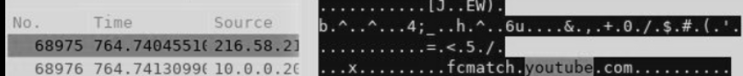

Web Browsing
Summarize the following:
What kind of traffic did you observe? Which protocol(s)?
The user was looking up a Youtube server. Protocol was TCP.
What, specifically, was the user doing? Which site were they browsing? Etc.
The user was watching Youtube.
Include screenshots of packets justifying your conclusions.
Include a description of any interesting files.

Slide 12
Making A Web Server
Summarize the following:
What kind of traffic did you observe? Which protocol(s)?
The user was creating a web server. Protocol KRB5.
What, specifically, was the user doing? Which site were they browsing? Etc.
The name of the server is “Frank-n-Ted-DC.frank-n-ted.com”. This is the server that the user was creating.
Include screenshots of packets justifying your conclusions.
Include a description of any interesting files.

Slide 13
Malicious Activity
‹#›

Slide 14
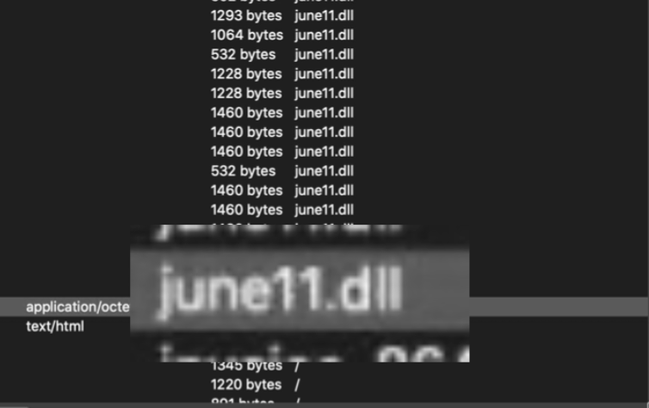
Malware
Summarize the following:
What kind of traffic did you observe? Which protocol(s)?
Malware. Protocol was HTTP.
What, specifically, was the user doing? Which site were they browsing? Etc.
The user was creating a file that eventually prevented the operating system from running properly. (june11.dll)
Include screenshots of packets justifying your conclusions.
Include a description of any interesting files.

Slide 15
Copyrighted Files
Summarize the following:
What kind of traffic did you observe? Which protocol(s)?
The user copyright a file. Protocol HTTP
What, specifically, was the user doing? Which site were they browsing? Etc.
The user copyrighted a file (Betty_Boop_Rhythm_on_the_Reservation)
Include screenshots of packets justifying your conclusions.
Include a description of any interesting files.

Slide 16
The End
‹#›

